Slide 1
ENB TOOL
B Raju (201285084)
G.Santhosh Kiran (201285088)
K.Mahesh (201285092)
M.Vamsi Krishna (201285094)
T.Naga Pavan (201285099)

Slide 2
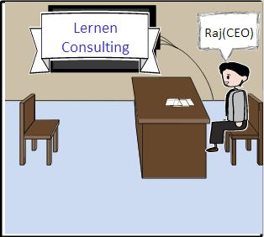
SIGMA CONSULTANCY
Sigma consultancy

Slide 3
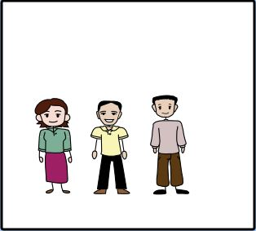
Employees in SIGMA Consulting
Sheela
Krishna
Ram

Slide 4
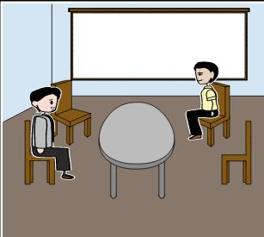
Good morning Krishna
Good morning Sir

Slide 5
Fine Sir. They’re going well
How is work at office?? How are projects going on??

Slide 6
Which project are you working on right now??
I'm working on PayPal Management System sir.
Which project are you working on right now??

Slide 7
No sir, I’ve worked on two projects before.
Is this your first project??
Is this your first project??

Slide 8
Mini Google & EBook Reader sir.
What are those projects??

Slide 9
Hmm..Not really sure about the duration of the projects sir..
Okay, So on which projects did your team spend too much time??
Hmm..Not really sure about the duration of the projects sir..
Okay, So on which projects did your team spend too much time??

Slide 10
Ughh..the first action item is setting the backend right for the project..and the second……
Ok leave it,
So what are your action items this week??

Slide 11
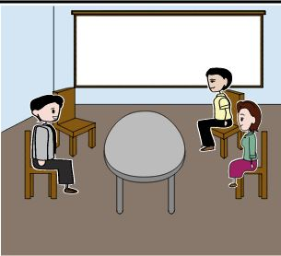
We have a documentation sir..but its not well organized.
It looks like you don’t have a clear knowledge
You should have maintained a documentation Mr. Krishna
….

Slide 12
???
I have a solution for this problem sir.
We can use ENB
???

Slide 13
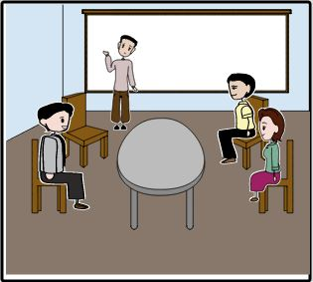
Yes, I’ve heard about it too. It is useful.
But its on paper, we need an automated one
???

Slide 14
Then lets have a team of engineers work on creating this ENB project

Slide 15
Uml diagrams

Slide 16
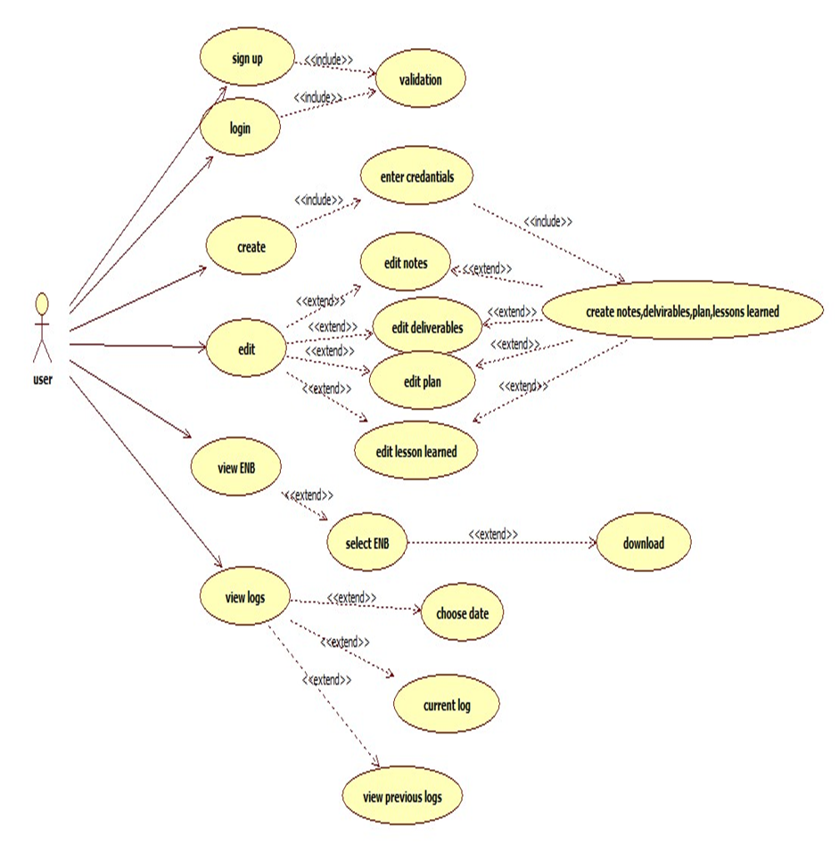
Use case model

Slide 17
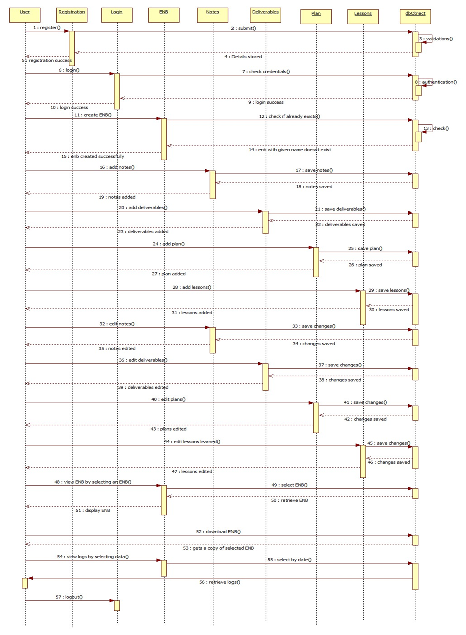

Slide 18
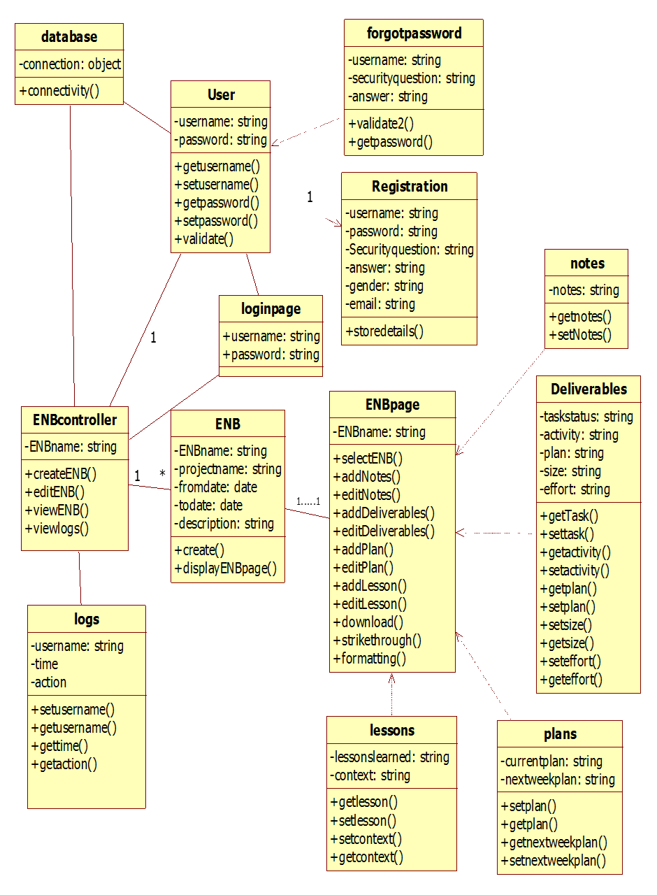

Slide 19
Techonologies used
Php
Html
Javascript
Mysql
Ajax
jquery

Slide 20
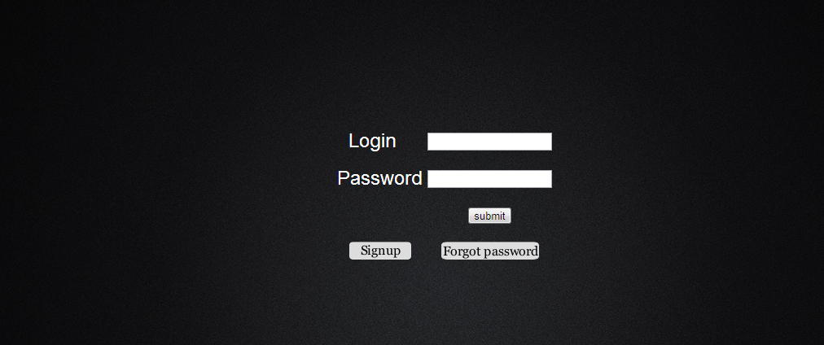
screens

Slide 21
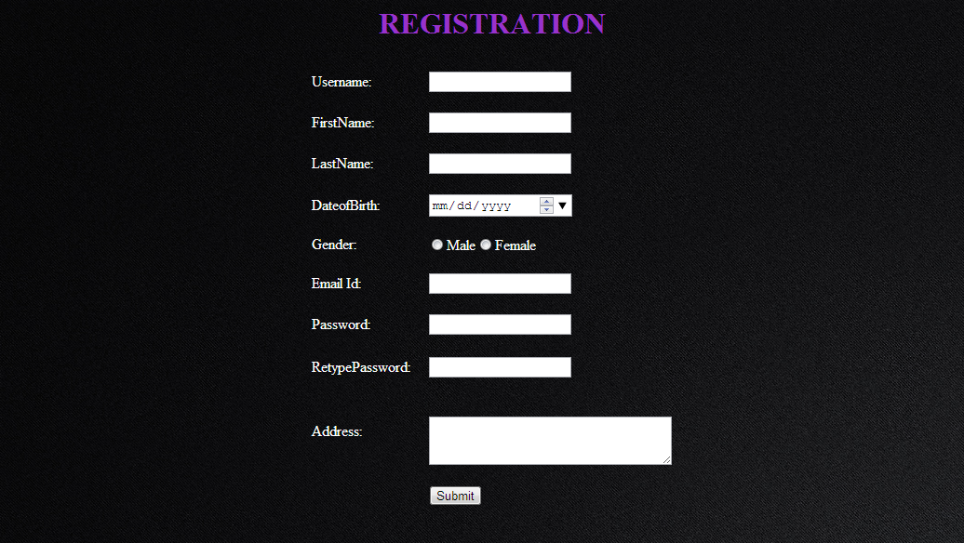

Slide 22
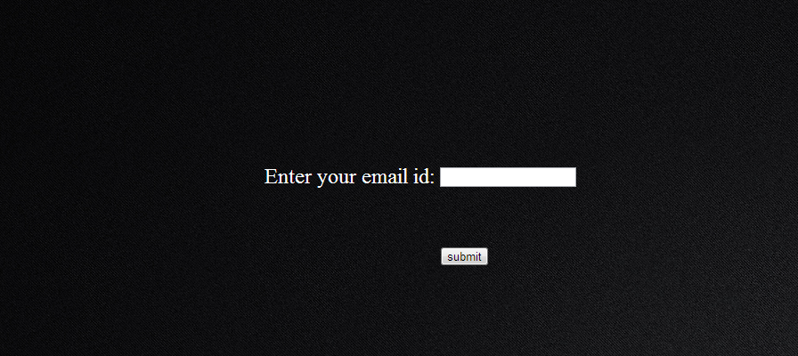

Slide 23
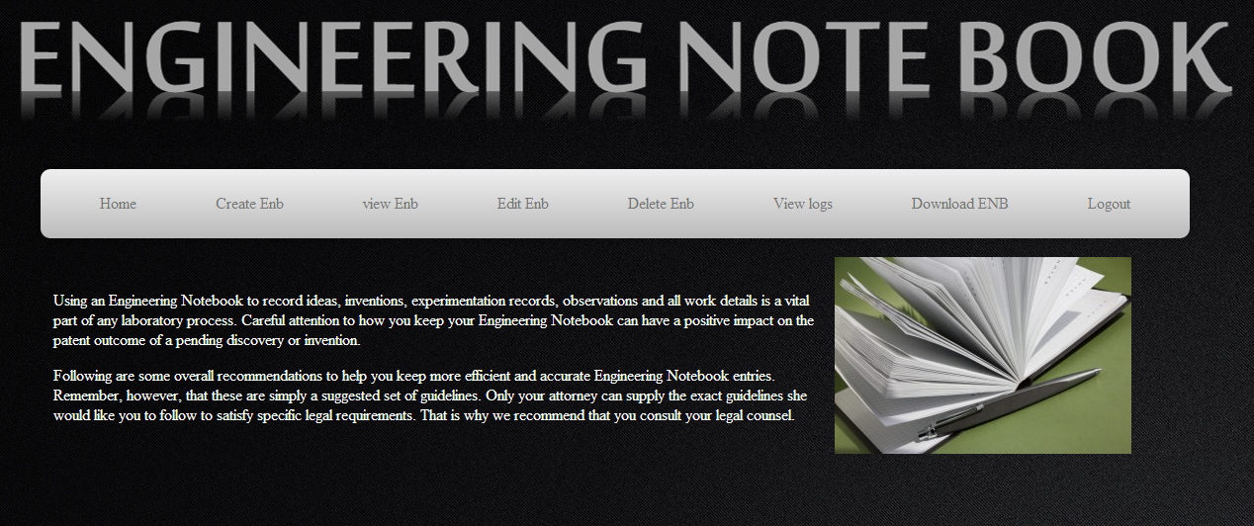

Slide 24


Slide 25
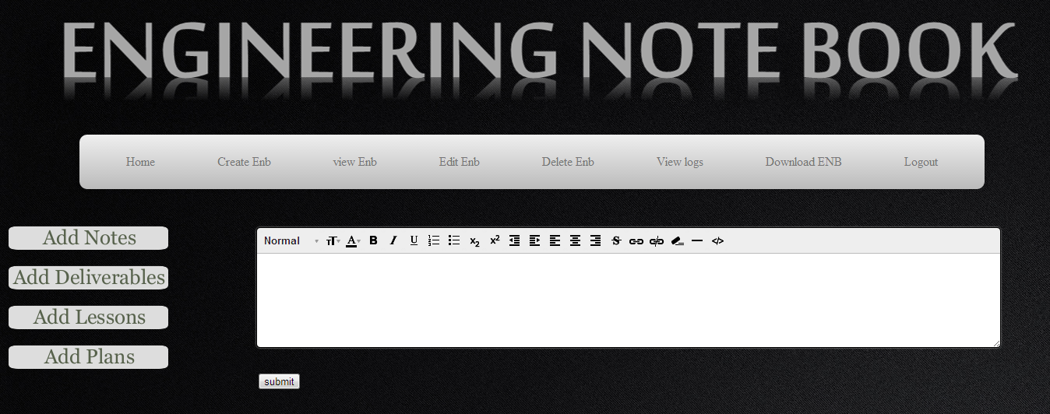

Slide 26
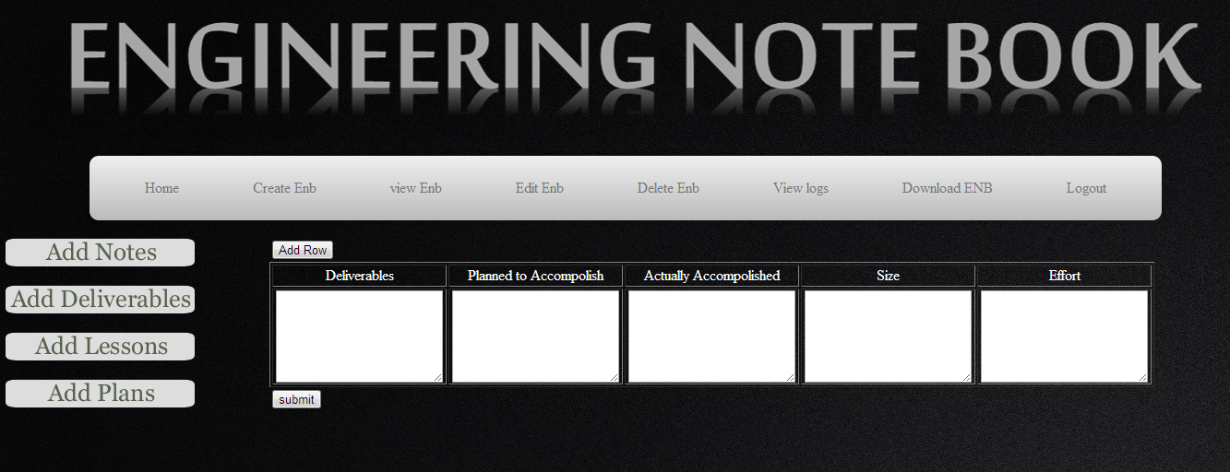

Slide 27
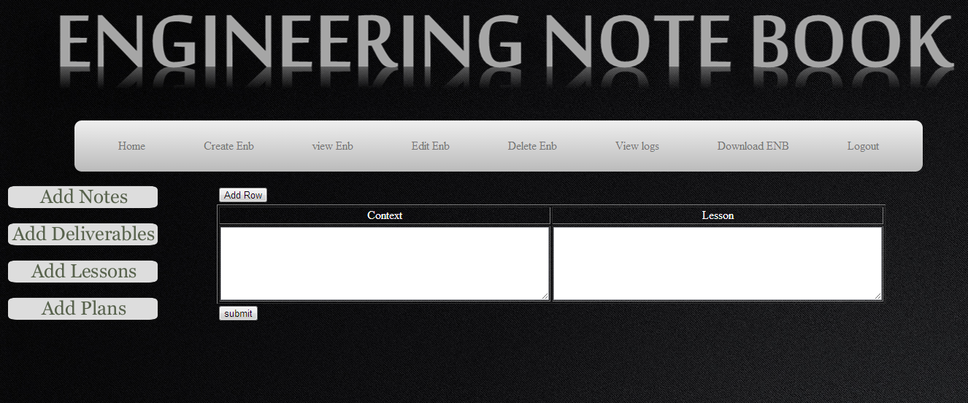

Slide 28
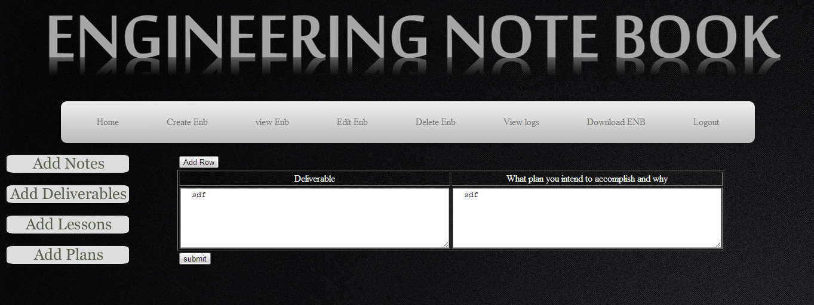

Slide 29
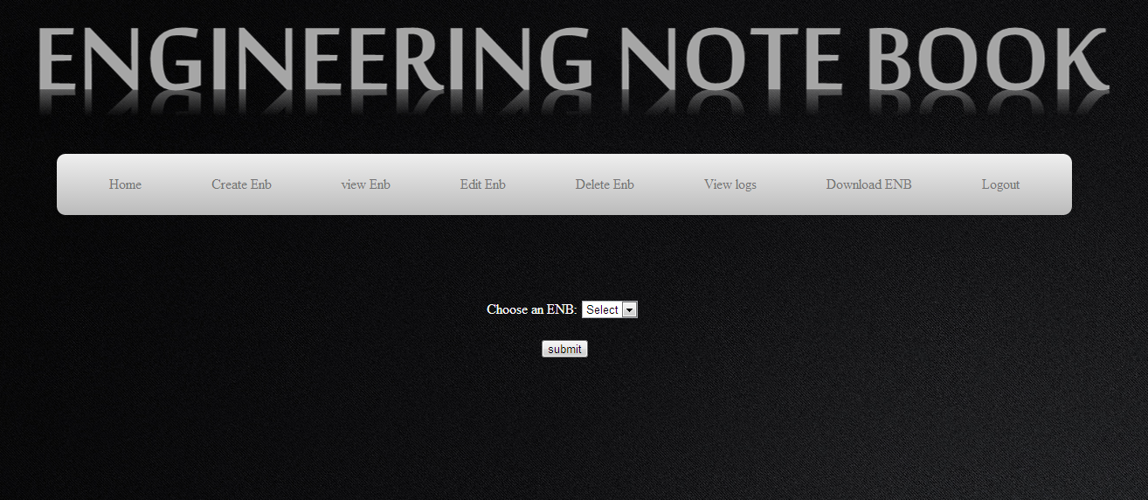

Slide 30
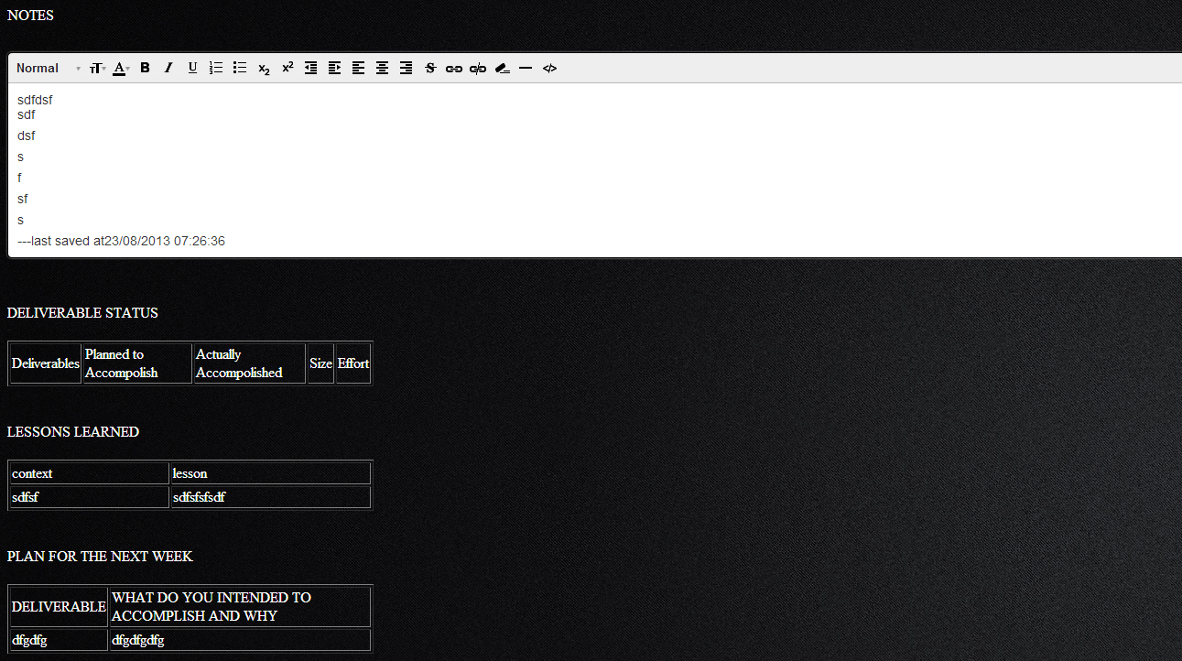

Slide 31
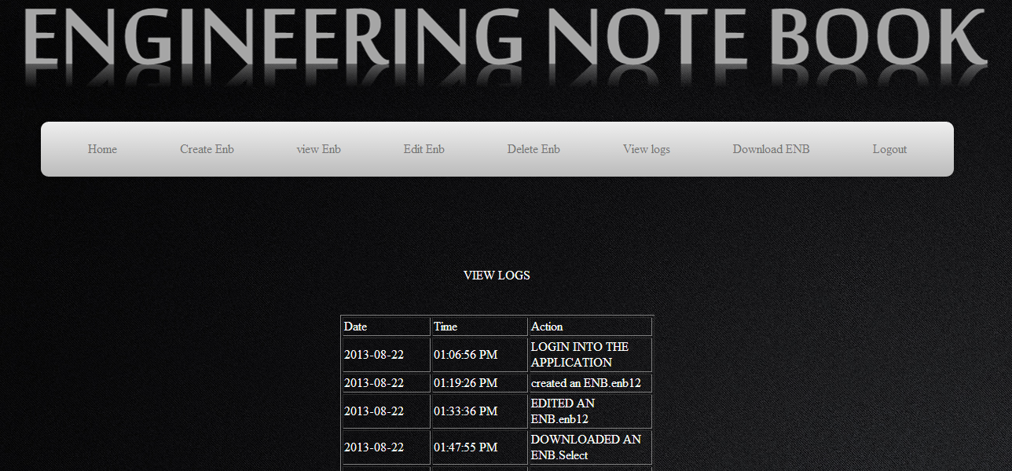

Slide 32
Contribution
B Raju (201285084) - Registration ,Login and Forgot password.
G.Santhosh Kiran (201285088) - Database Design
K.Mahesh (201285092) - Text Editor and Pdf generation
M.Vamsi Krishna (201285094) - Front end design , User interface
T.Naga Pavan (201285099) - Create Enb, Edit Enb , Viewlogs,Delete ENB, Download ENB

Slide 33
Schedule
Week 6 – Learning PHP and database connectivity
Week7 - Registration , login and database design , User interface , Create ENB , Edit ENB
Week8 - Functionalities of ENB , PDF Generation , text Editor

Slide 34
Conclusion
Finally Raj is happy with the application we have developed

